Slide 1
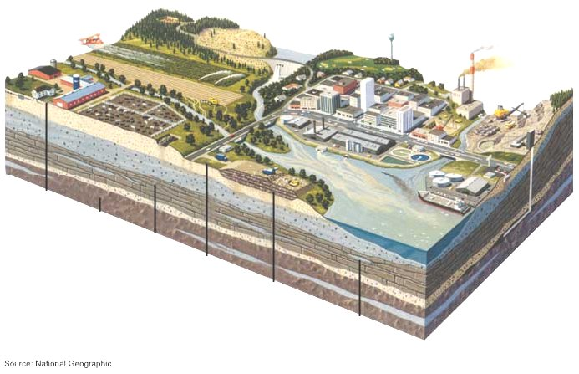

Slide 2
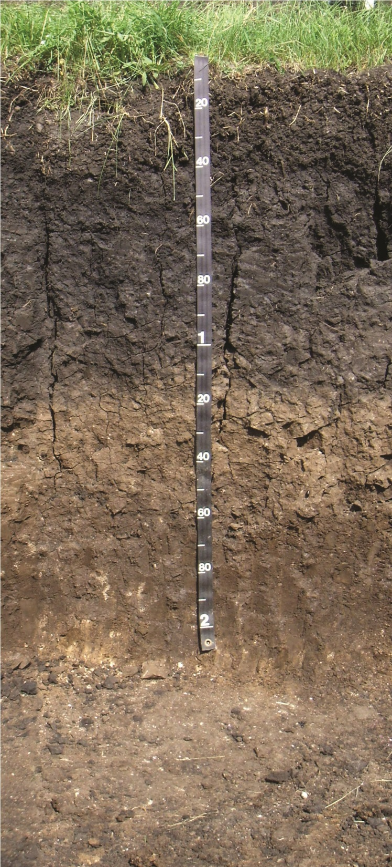
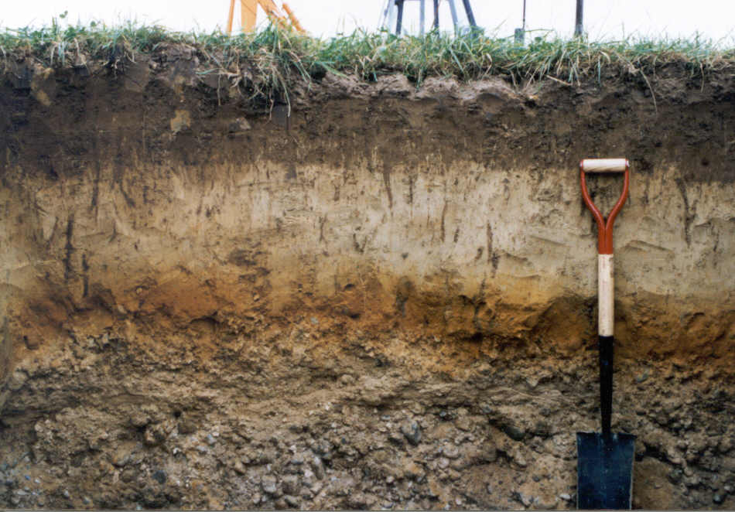
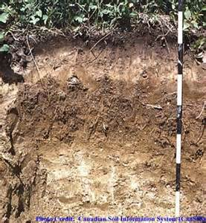
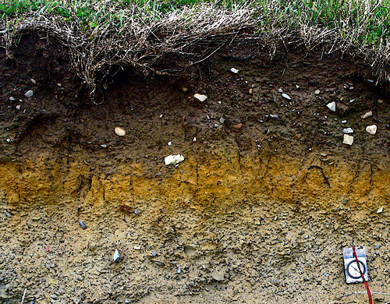
SOIL PROFILE

Slide 3
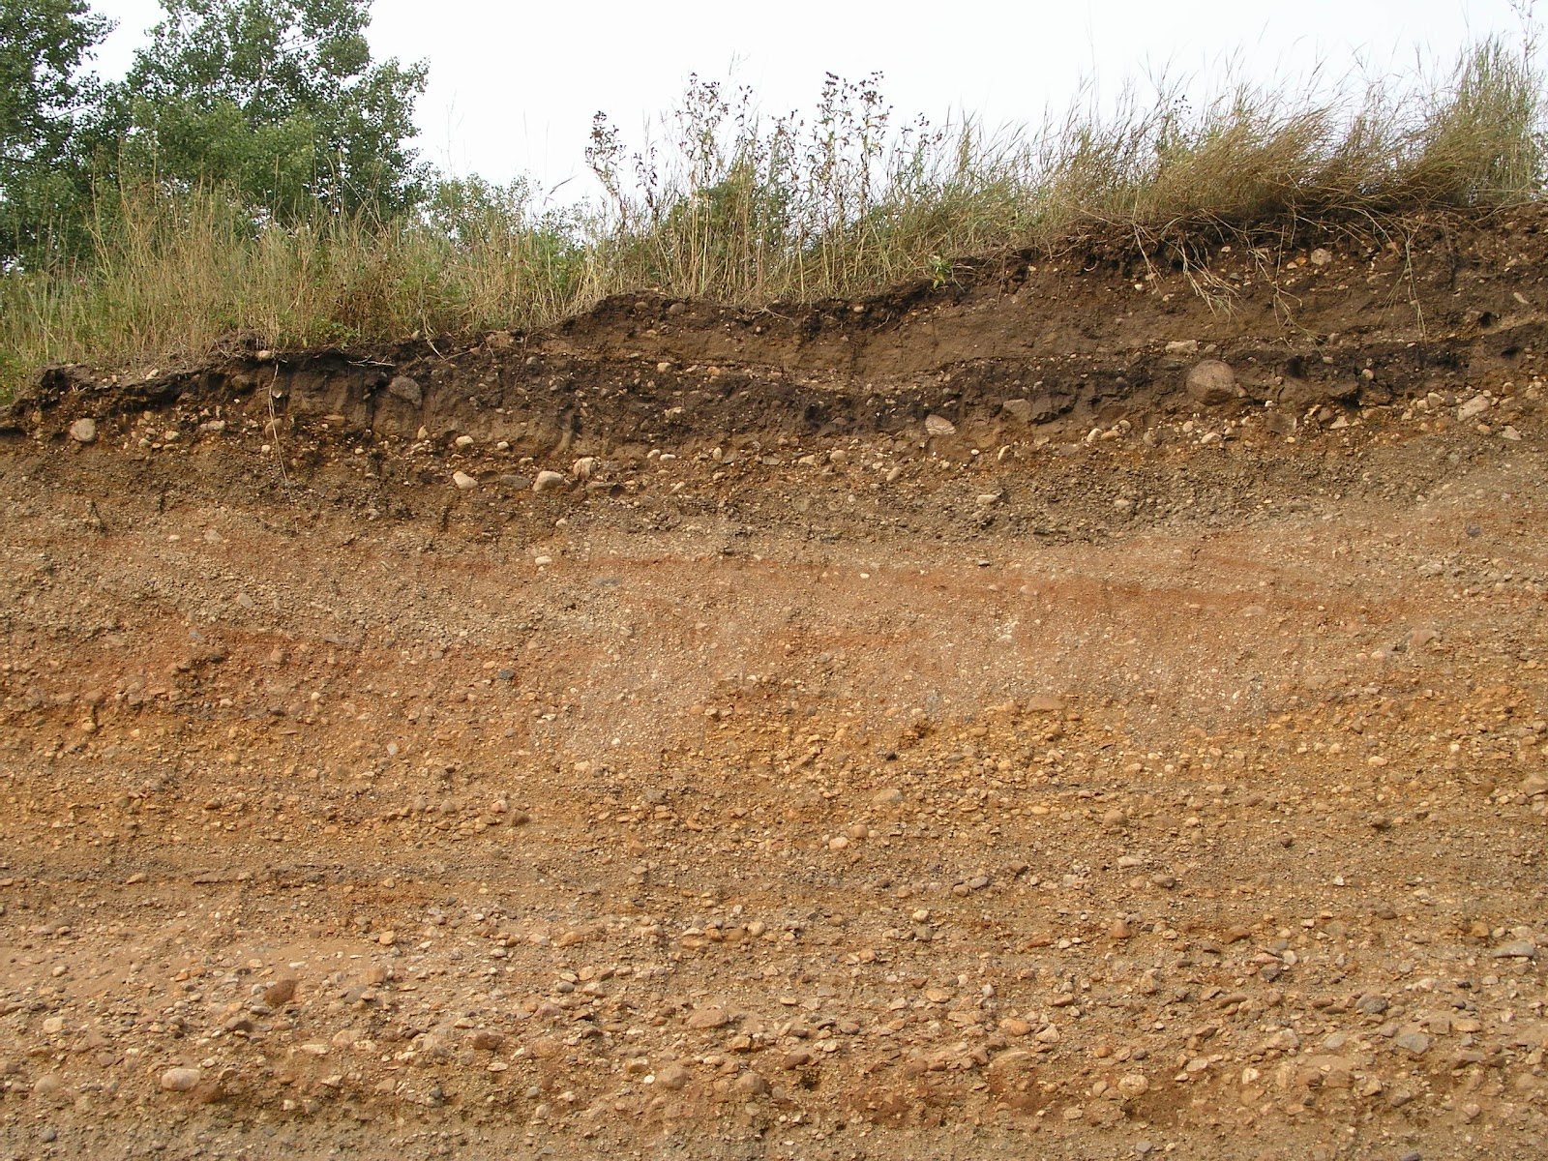

Slide 4
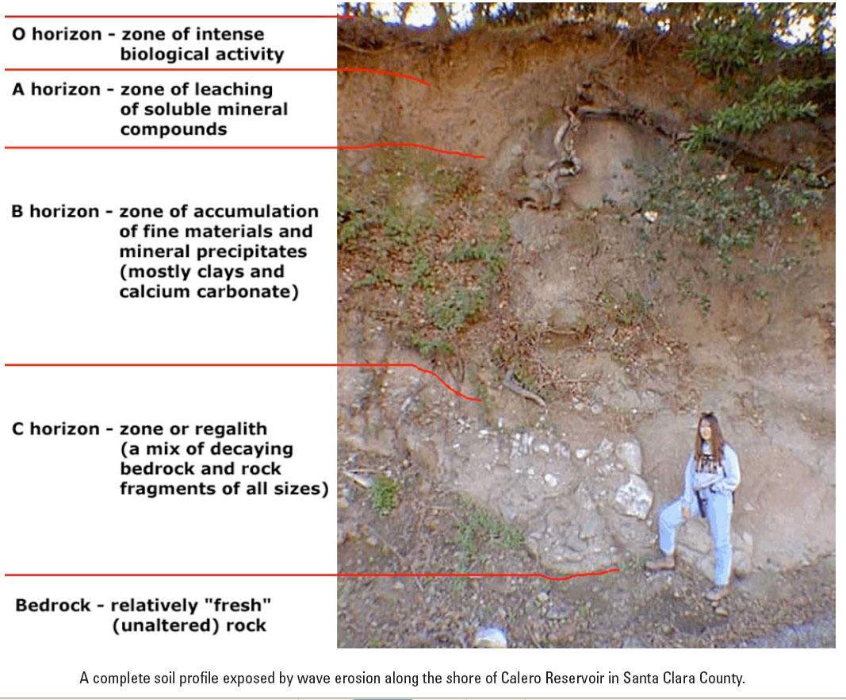

Slide 5
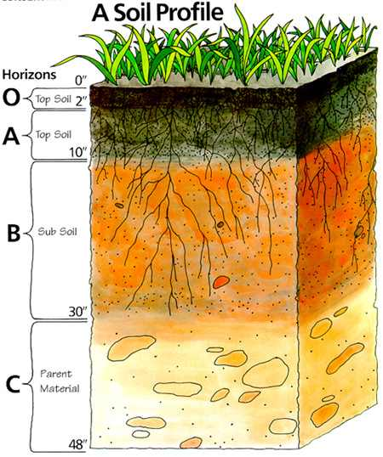

Slide 6
MACROSCOPIC APPROACH
porous media
(soil matrix)
–
defined over a domain
-
heterogeneous system of solid particles forming pores
(voids)
pore space
-
has to be
interconnected
-
distributed throughout the entire
domain
-
occupied by
fluid phases
(one
gaseous and one or more liguid
phases)
It can be studied at various levels of spatial resolution:
corresponding to a certain
scale
, e.g.
1.
molecular
2.
microscopic
3.
macrosc
opic

Slide 7
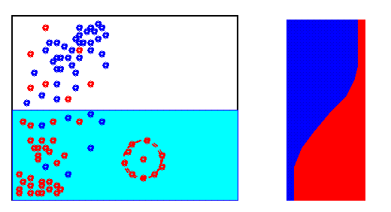
      molecular - movement of particular molecules
      (chemical reactions)
example: vapor, volatile gases

Slide 8
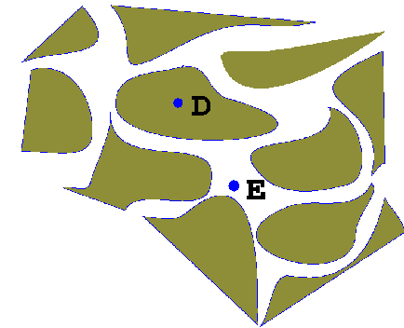
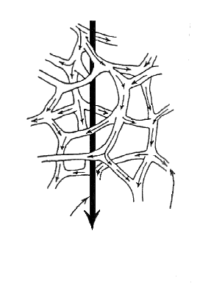
microscopic - level of individual pores
Darcy’s
flow
flow
in pores
    phase microcontinua are distributed
    continously in sub-domains of space
    boundaries between them have to be known
in one point of space in one time allways only one microcontinuum (one phase)
mathematical description - Navier Stokes equations,
Young Laplace equation
e.g., fluid velocity in particular pores

Slide 9
    macroscopic - particular liquid phases or desolved
    substances (partitions of chemical
    species) are substituted by a number of
    mutually overlaping fictive macrocontinua
    macrocontinuum is distributed throughout
    the entire flow domain, no boundaries defined
(needed to be defined)
Darcy’s
flow
flow
in pores
    at one point of a domain at the same time arbitrary number of macrocontinua

Slide 10
CONCEPT OF REPRESENTATIVE ELEMENTARY VOLUME
  (Representative Elementary Volume - REV)
  small volume, size >> characteristic pore size
      << studied domain
Having a REV the continuum is acquired by the volume averaging
  Values of macroscopic state variables we assign to a point,
  the geometric center of REV (REV considered as a centroid)

Slide 11
Moving REV through every point within the domain, so that we repeat this procedure for all points within the considered flow domain, we obtain continuous field of values of macroscopic state variable P (e.g., fluid velocity, fluid density, or pressure heads), which can be thus expressed as continuous function of space co-ordinates.
Result of averaging – the model substitution of real phases by a series of fictive macrocontinua.
We assume, that the entire porous media is formed as a superposition of partial phases macrocontinua.

Slide 12
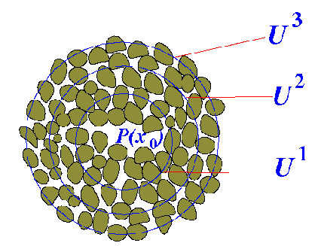
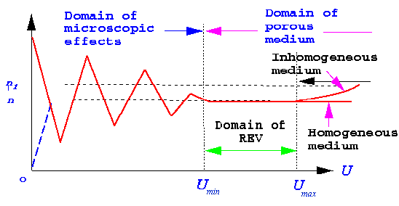
Determination of the REV‘s size
  consecutive averaging over arbitrary elementary volume (Arbitrary Elementary Volume - AEV) – a small spherical volume centered at the selected fixed point
  very small volume to start with
  this volume is gradually increased
  when after a small increase of a volume the value of macroscopic state variable does not change (more or less), this AEV then may be considered to be the REV
  it holds for the macroscopically homogeneous porous medium only
  for the macroscopically heterogeneous porous medium the size of REV is not unique
Similarly to REV the representative elementary area is defined
(Representative Elementary Area - REA)

Slide 13
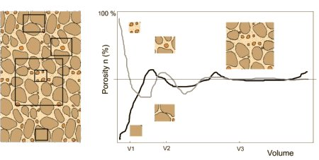
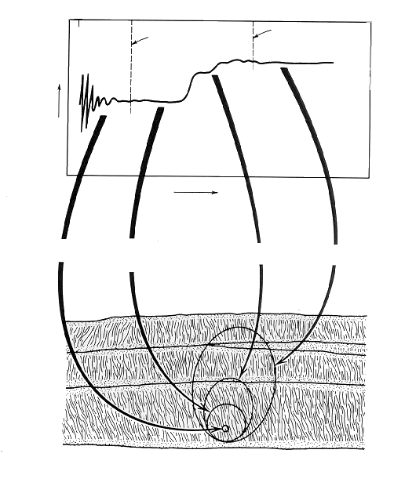
Reality
0
0
REV
REV
REV
1
REV
1
2
2
měřená vlastnost
  mutual dependence on the size of the sample
  effects of heterogeneity have to be considered
macroscopic property
volume AEV
objem V
vliv pórů
pores
two layers
vliv rozhraní
profil
uvnitř vrstvy
profile
one layer

Slide 14
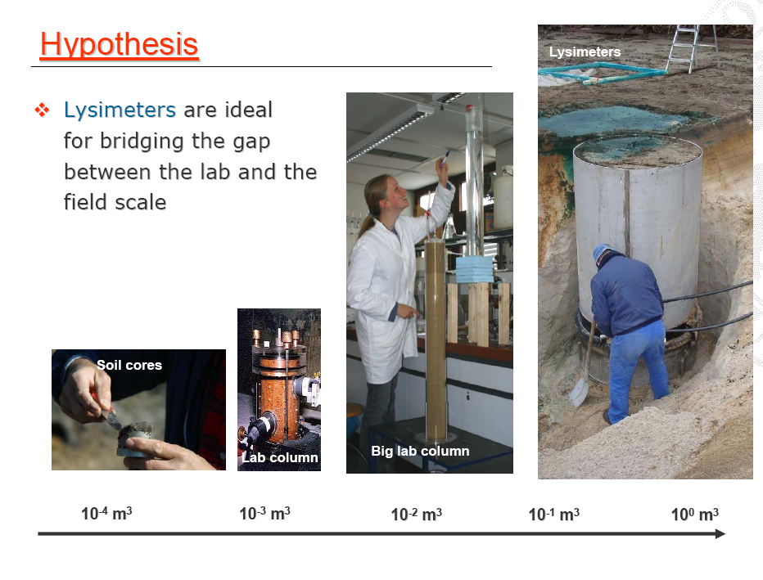

Slide 15
VOLUME AVERAGING
Two types of averaged values
1)
averaging over the entire REV domain:
ˆ
mac
=
1
∫
mic
(1)
P
P
dV
α
V
α
V
where
P
mic
arbitrary microscopic state variable of the phase
α
α
ˆ
P
mac
corresponding
macroscopic average
of a state variable
α
V
volume REV
2)
averaging over a REV sub
-
domain, where the phase
α
is
present (volume
V
α
):
mac
=
1
∫
mic
P
P
dV
(2)
α
V
α
α
V
α
P
mac
macroscopic
intrinsic
phase average
of a state variable
α
V
α
volume of the phase
α

Slide 16
both averaged values are related as
ˆ
mac
=
ε
mac
ε
=
V
α
P
P
where
α
α
α
α
V
and
ε
α
is
volumetric fraction of the phase
α
.
Basic state variables
  macroscopic state variables describing the state of moving liquid phases (constant temperature assumed) :
    velocity
    density
    pressure

Slide 17
  DENSITY OF A PHASE
macroscopic density of a phase α (averaged over REV)
    (for water about 1 kg/l)
The other quantity, the macroscopic intrinsic density ρ_{α} , averaged using equation (2) (for water
the number closed to the microscopic density), would be centered over a part of REV only
an example: specific density versus bulk density

Slide 18
ρ
for macroscopic densities
ˆ
α
the princip of superposition can
be used (they are additive). When all phases added together,
we get
ρ
=
ρ
ε
=
∑
ˆ
ˆ
,
∑
1
α
α
α
α
ρ
where
ˆ
is a macroscopic density of the entire porous medium

Slide 19
VELOCITY OF A PHASE
macroscopic velocity (intrinsic phase average) is obtained by averaging over the representative elementary area (REA), perpendicular to the direction of the flow
=
1
∫
=
1
∫
mic
ˆ
=
ε
v
v
mic
dA
,
v
dA
,
v
v
[m/s]
α
A
α
α
A
α
α
α
α
α
A
α
A
α
where
A
is the REA
A
α
is the part of REA, occupied by a phase
α
.
    quantity v_{α} is the macroscopic velocity of the considered phase α
    quantity _{α} is a volumetric flux (volume averaged velocity)
    velocities are not a scalar but a vector, we do not average the values only, but also the direction of flow

Slide 20
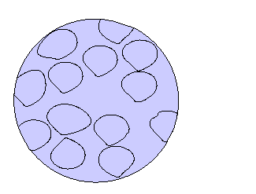
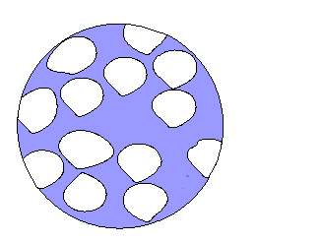
volumetric flux of a phase
    (not to mix the velocity of a phase (mean pore velocity) X the volumetric flux)
    we will assign the volumetric flux as
- a volume of a phase α which flows through a unit area in a unit of time
(Darcy’s velocity or flow rate)
Another used names: specific discharge, flux density, filtration velocity, etc.
Darcy’s flow
[LT⁻¹]
volumetric flux q
mean pore velocity v
A
= A
*
p
α
q = v * p
area A
area A _{α}
p
porosity

Slide 21
PRESSURE IN A PHASE
Macroscopic pressure in a phase α is obtained by averaging over the phase α (variable obtained by averaging over the entire REV is not used).

Slide 22
PRESSURE IN A PHASE
    Pressure head is the pressure expressed in length units (the height of the corresponding water column)
    It is used even in cases of other phases α , others than water
    A real water density can be used instead of the reference water density. Pressure head is then a ratio of the two macroscopic variables.
    Different description has to be used when water is considered to be a compressible liquid, when strongly polluted or when the non-isothermal processes are treated (different in the subsurface hydraulics)

Slide 23
CONTINUITY EQUATION OF A PHASE
the basic relationship between macroscopic fields
it represents the mass balance of the continuum
expresses (a certain form) of mass conservation
of the boundary Ω
the first term – temporal change of the mass of a phase in the considered volume within the time interval dt
the second term - net outflow, the difference between the part of mass of a phase, leaving the considered volume and the mass entering this volume at the same time interval
(the outflow is considered as plus, the inflow as minus)

Slide 24
Gauss theorem
∫
div
a
dV
=
∫
a
n
d
Ω
V
Ω
where
a
is an arbitrary continuous vector field
∂
a
∂
a
y
∂
a
div
a
=
x
+
+
z
∂
x
∂
y
∂
z

Slide 25
FLOW OF WATER IN THE VARIABLY SATURATED POROUS MEDIA
Vadose zone (unsaturated zone, zone of aeration)
    ground surface
    groundwater level
    impermeable bottom
    infiltration of precipitation, excess irrigation, influent river
    capillary rise from groundwater level
    the entire void space is occupied by one or two fluid phases
    (air and water)
    contaminants carried with water

Slide 26

Characteristics of porous media
given by geometry of pore space
    particle size distribution
    specific density (g/cm³)
    bulk density (g/cm³)
    porosity (cm³/cm³)
    permeability (cm²)
    dispersivity (cm)

Slide 27
Driving forces of the flow
Water in subsurface is exposed to a number of force fields
The usually considered ones:
gravitational forces
pressure forces
retention forces
- capillary forces - an interfacial tension in capillaries on the interface between gaseous, liquid and solid phases (these forces vanish when the medium is fully saturated)
- adhesive forces - a thin film of water coating the solid phase surface
2

Slide 28
Forces are expressed by means of total potential:
Total potential
φ
–
the superposition of particular potentials
(a simplified approach – leading to a formally equal description of
flow in saturated and unsaturated porous media):
φ
=
ψ
+
ψ
+
...
[
J/kg
]
p
g
where
ψ
pressure potential
pressure and retention forces
p
ψ
gravitational potential
g
Potential expressed in pressure units
′
φ
=
ρφ
=
p
+
ρ
=
ρψ
ρ
=
ρψ
gz
[
Pa
]
,
p
,
gz
p
g

Slide 29
In engineering applications as pressure heads in units of length:
:
φ
ψ
p
H
=
=
h
+
z
[
m
]
,
h
=
p
=
g
g
ρ
g
where
H
hydraulic head
h
pressure head
elevation in the gravitational field, that means the vertical
distance above the arbitrary reference level)
z
ρ
water density ( we will assume that
ρ
ω
=
ρ
o
=
ρ
)
w
p
pressure
(state variable)
g
the acceleration of gravity
when potential within the flow domain constant - all forces in equilibrium
- no flow
otherwise the flow in direction between the location of the higher potential
towards the location of the lower potential
3. velocity of flow is proportional to the difference of the total potential (Darcy‘s law)

Slide 30
Another components of the total potential may be used
osmotic potential - the difference in concentrations on two sides of
semi-permeous membrane (e.g., an extraction of
water by plant roots)
(For more general formulation see Bear, Verruijt, Modeling Groundwater Flow and Pollution, Kluwer Academic Publishers, Dodrecht, 1994, pp.123 -135
For the exact thermodynamic formulation – based on the specific Gibbs energy – complications with applications –see e.g.
Gray a Hassanizadeh, 1991, WRR 27:1847-1854
Nitao a Bear, 1996, WRR 32(2):225-250)

Slide 31
Capillary forces
Capillary forces determined - composition of the present phases
    - geometry of interfaces
    - temperature
influence of capillary forces ( capillary pressure p_{c})
    capillary pressure head h_{c} = p_{c} /ρ g
    (the difference of the capillary heads in the capillary at
    the interface between the water and the air)

Slide 32
The Laplace, or Young-Laplace formula for capillary pressure is applied:
⎛
1
1
⎞
2
σ
p
=
σ
⎜
+
⎟
=
c
⎝
r
′
r
′
′
⎠
r
∗
where
r
*
the mean radius of capillary meniscus
σ
surface tension (for pure water under 20
°
C it is 0.0728
N/m)
r'
and
r''
the principal radii of a curvature
For a circular capillary located partially under water
2
σ
cos
ϕ
C
h
=
schematically:
h
=
1
c
ρ
c
gr
r
where
ϕ
contact angle
(wetting angle) at the contact of the
three phases (water
–
air
–
solid)
r
radius of the capillary
ρ
water density
The assumption: the air pressure in pores is equal to the atmospheric pressure (h_{a} = 0),
then:

Slide 33
Pressures in vertical capillary

Slide 34
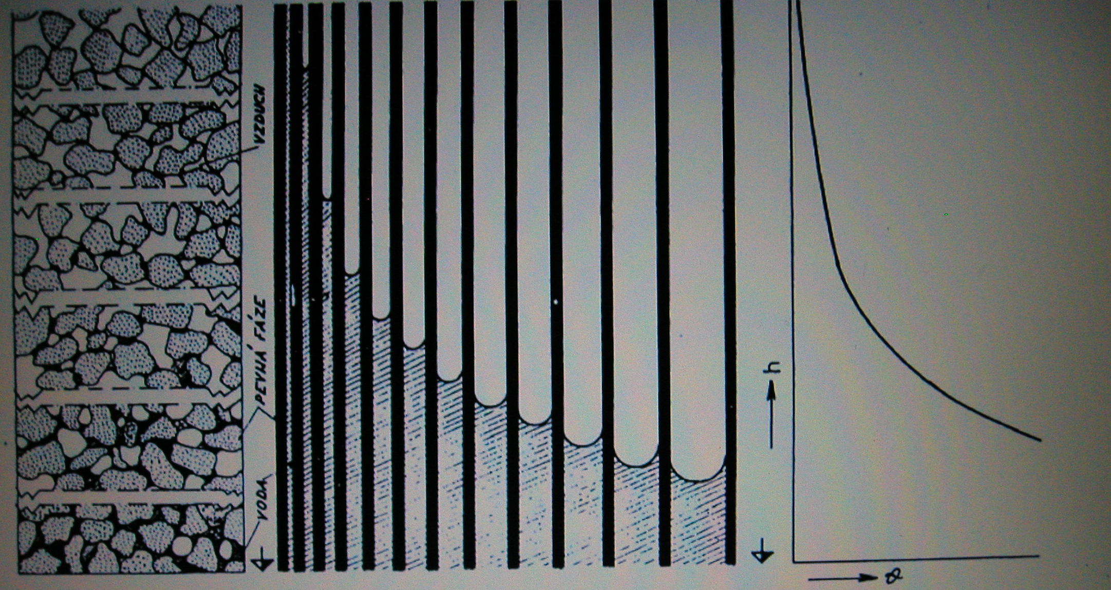
retention curve
air
solid phase
water

Slide 35
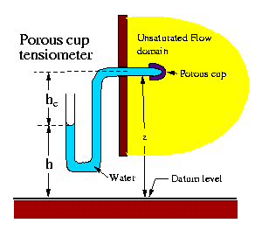

Slide 36
Wetting and draining of a porous medium
Dependent on:
- - distribution of water within the flow domain
- - physical condition of the wetting and draining of the pore space
Hydraulics of porous medium of particular soil is fully defined by
Soil Hydraulic Characteristics
retention curve – measured relationship between soil moisture content and
retention forces
hydraulic conductivity function – the ability of the porous medium to conduct liquids

Slide 37
Soil moisture content
volumetric moisture content
θ
the measure of the volume of water present in
the pore space
θ
=
V
w
V
degree of saturation
S
, or
efective moisture content
θ
e
:
θ
θ
−
θ
S
=
θ
=
r
θ
,
e
θ
−
θ
s
s
r
where
θ
s
saturated moisture content (all pores filled)
θ
r
residual moisture content (does not participate on flow)

Slide 38
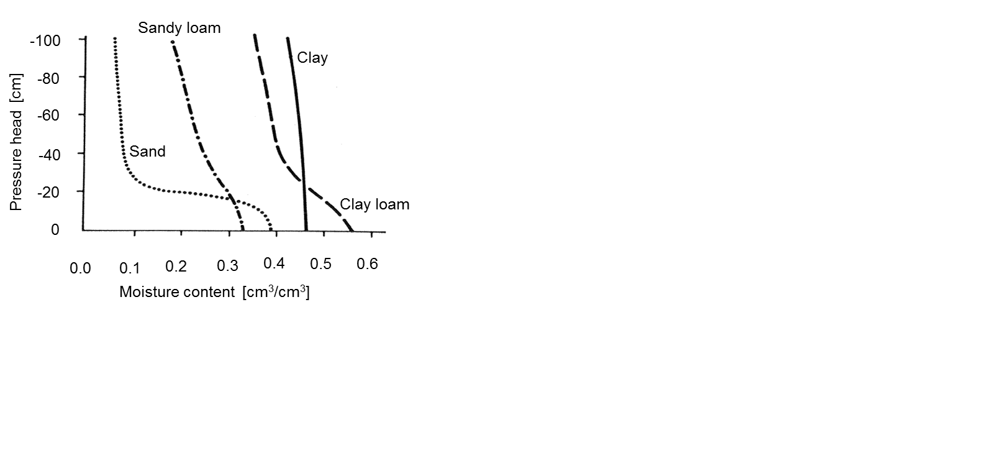
Retention curve
an equilibrium hydraulic characteristic of a porous medium
  in the unsaturated porous medium water held by capillary forces
  their intensity indirectly related to the degree of saturation
  in full saturation capillary forces vanish (and the influence of adhesive forces is negligible)

Slide 39
Retention curve
Functional relationship between the moisture content and the capillary suction head ( θ = θ(h_{c}) or S = S(h_{c}) or θ_{e} = θ_{e}(h_{c}) )
The assumption (capillary model of the porous medium):
  the porous media consists exclusively of the capillary pores
  (~ pores < 1 mm)
  the pore network is interconnected
  the constant density of water
What happens, when water saturation is reduced (drainage) from the soil, and when saturation is increased (wetting, imbibition) ?
as the soil is being dried, water is drained from the pore space, and air fills up the
evacuated space. As water leaves the pore space, the large pore drain first, as long as
a continuous pathway of pores which are occupied by water exists
during wetting the smallest pores fill the first, in dependence on the initial saturation
to each moisture content it corresponds
  a certain curvature of capillary menscii
  thus the capillary pressure (generalized Laplace‘ formulae)

Slide 40
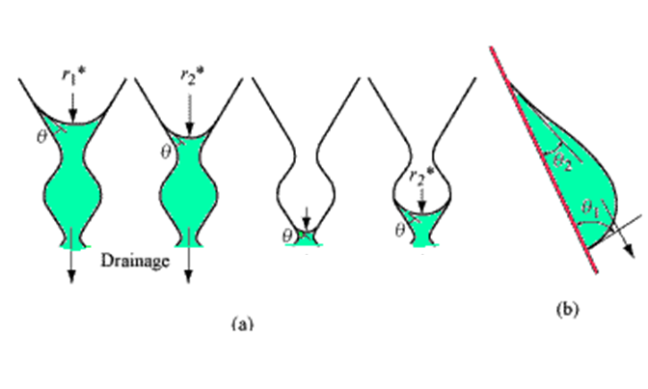
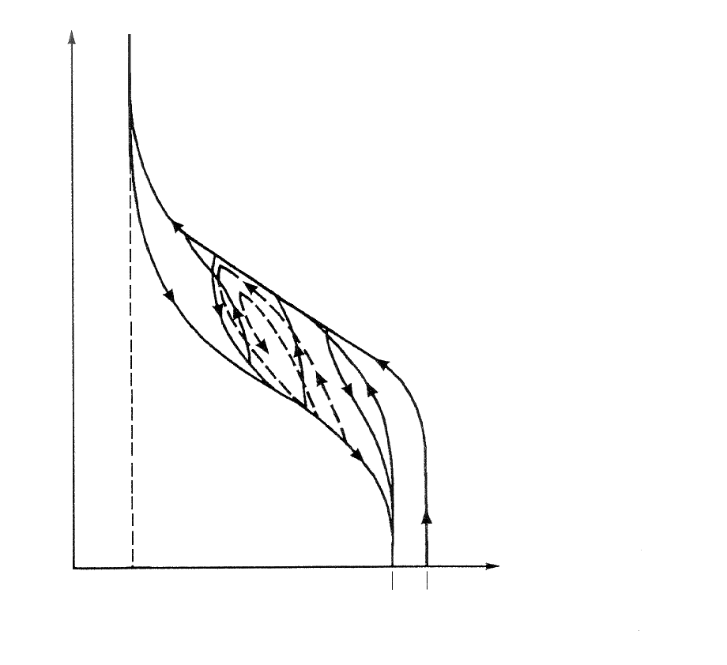
Retention curve hysteresis – in dependence on the history of the filling/draining
process the hysteresis loop forms
  2 envelope curves (the main wetting and draining curves/branches)
  ”family" of wetting and draining scanning curves
h
c
Main drainage
Ink bottle (a) and raindrop (b) effects
curve
Main wetting
curve
0
0
θ_{r}
residual
θ_{sw}
θ_{sd}
θ
moisture content
trapped air

Slide 41
Derivation of the retention curve is called
specific (water) capacity:
=
−
d
θ
C
(
h
)
c
dh
c
(a)
sand
(b)
sandy loam
(c)
sandy clay loam
(d)
clay loam
(e)
clay

Slide 42
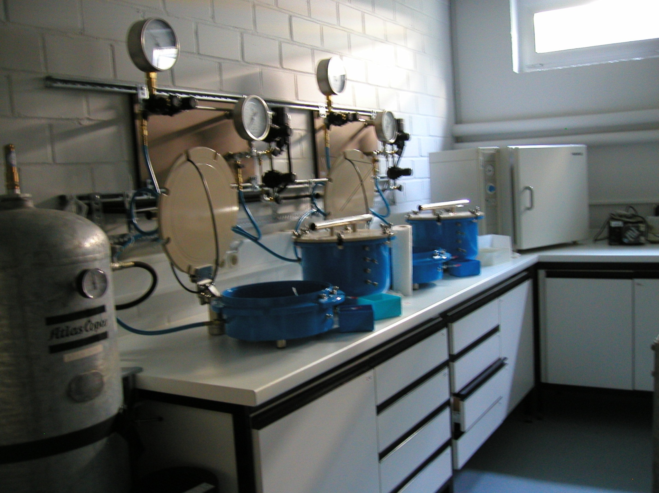

Slide 43
Hydraulic conductivity function
- the measure of the porous medium to conduct water
Hydraulic conductivity of one capillary
velocity of the laminar flow Hagen-Poiseuille law (for a circular capillary)
ρ
g
dH
u
=
−
r
2
8
μ
dl
where
u
average profile velocity
H
=
h
+
z
hydraulic head
dH/dl
hydraulic gradient
μ
dynamic viscosity of water [Pa s]
l
spatial coordinate in direction of the axis of
the capillary
the validity criterion - Reynolds number
-
Re
=
qd
ρ
/
μ
where
d
characteristic microscopic length of porous medium [L]

Slide 44
hydraulic conductivity of straight circular capillary
K_{l}
dH
ρ
g
u
=
−
K
(
r
)
,
K
(
r
)
=
r
2
K
(
r
)
=
C
r
2
1
dl
1
8
μ
1
2
u
l
local velocities in the capillary

Slide 45
empirical introduction of the hydraulic conductivity
Darcy
-
Buckingham law
-
relationship between driving forces of the flow and the volumetric flux of water
where
q
the vector of the volumetric flux [LT⁻¹]
K
(
θ
)
the tensor of the hydraulic conductivity
[LT⁻¹]
⎡
K
(
θ
)
K
(
θ
)
K
(
θ
)
⎤
⎢
11
12
13
⎥
K
(
θ
)
=
⎢
K
(
θ
)
K
(
θ
)
K
(
θ
)
⎥
21
22
23
⎢
K
(
θ
)
K
(
θ
)
K
(
θ
)
⎥
⎣
31
32
33
⎦

Slide 46
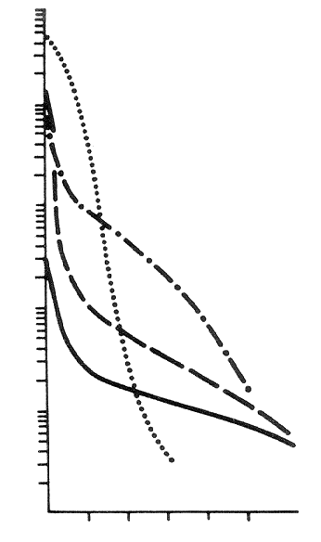
Relation between suction pressure head and hydraulic conductivity
(see retention curve (RC))
K(h)
In full saturation (h = 0) K(h) = K_{S}
K_{S} is saturated hydraulic conductivity [LT⁻¹]
1000
K(h)
100
Hydraulic conductivity function may be expressed as
den]
/
[cm
10
K
(
h
)
=
K
(
h
)
K
*
r
s
where
K
*
is measured saturated hydraulic conductivity
1
Sandy loam
s
Hydraulic conductivity
K_{r}(h) is relative hydraulic conductivity (dimensionless),
a function predicted from the shape of the RC
0.1
Clay loam
hydraulic conductivity is given by
  - geometry and surface properties of a solid phase
  - properties of a liquid phase
Sand
Clay
0.01
0 20 40 60 80 100
Capillary pressure head
[cm]
a characteristic independent on the properties of a liquid phase exists:
permeability k [L²] :

Slide 47
Continuity equation
- the general equation of the mass balance of a phase
(here water)
∂
(
θρ
)
+
div
(
θρ
v
)
=
0
∂
t
where
v
vector of macroscopic velocity of the flow
When the changes of the density are not considered (neglected)
∂θ
+
div
q
=
0
(
q
=
θ
v
)
∂
t

Slide 48
Equation of the flow of water
changes of state variables (water content, pressure and velocity) in time and space
within an arbitrary flow domain – Richards‘ equation (RE):
Simplifying assumptions :
The pore geometry of natural porous medium (soil) is in a „good agreement“
with the capillary model, the medium (solid phase) does not move and does
not deform
The influence of the air flow on the flow of water is ignored (the pressure
of the air in pores is constant and equals to the atmospheric pressure
Flowing water is incompressible

Slide 49
1D Richards’ equation in vertical direction
∂θ
∂
⎛
∂
⎞
=
h
+
⎜
K
K
⎟
∂
∂
∂
t
z
⎝
z
⎠
-
h
(
z,
t
)
θ
(
z
,
t
)
Unknowns
pressure head
, or moisture content
capacity form
of Richards’ equation:
∂
∂
⎛
∂
⎞
h
=
h
+
−
∞
<
<
+∞
C
(
⎜
⎟
h
)
K
(
h
)
K
(
h
)
,
h
∂
∂
∂
t
z
⎝
z
⎠
=
−
d
θ
retention capacity
C
(
h
)
dh
diffusive form
of Richards’ equation:
∂θ
∂
⎛
D
∂θ
⎞
=
⎜
(
θ
)
+
K
(
θ
)
⎟
θ
<
θ
∂
t
∂
z
⎜
∂
z
⎟
s
⎝
⎠
D
)
d
h
diffusivity
(
θ
=
−
K
(θ)
d
θ

Slide 50
Sources and sinks
-
added/subtracted (e.g., water extraction by plant roots
∂θ
=
div
(
K
grad
h
+
K
)
−
S
,
S
=
S
(
x
,
t
)
for
x
∈
Ω
∂
t
∗
3
R
S
=
0
for
x
∉
Ω
R
where
S
extraction intensity [s
-
1
] (
S
-
sink term)
x
=
(x,
y,
z)
spatial coordinates vector
transpiration
irrigation
evaporation
Γ
Γ
N
Γ
Γ
N
D
D
Ω
Γ
R
Γ
N
N
boundary
Ω
of zero flux rate
Γ
GWL
D

Slide 51
Initial and boundary conditions
the flow equation is solved for the given time interval and the defined flow domain
Initial conditions
distribution of the unknown function (e.g., the pressure head h) within the flow domain
at the beginning of the flow process
h
(
x
,
0
)
=
h
(
x
)
o
where
h
o
(
x
)
is the field of pressure heads in the entire flow domain at the time
t
=
0
θ
(
x
,
0
)
=
θ
(
x
)
o
where
θ
(
)
o
x
is the prescribed initial moisture content distribution
Boundary conditions
interaction of the system under study with its neighbourghood at the boundary
of the flow domain

Slide 52
Pressure head boundary condition
(Dirichlet)
at the part of the boundary of the flow domain the pressure head is known
(or moisture content)
h
(
x
,
t
)
=
h
(
x
,
t
)
for
x
∈
Γ
D
D
where
h
D
are prescribed values of the pressure heads at the selected/given
part of the boundary
Γ
of the flow domain
Ω
(part of Γ_{D} boundary )
Flux boundary condition
(Neumann)
over the part of the boundary water flows in/out of the system in (under)
a known velocity
n
q
=
−
n
(
K
grad
h
+
K
)
=
q
(
x
,
t
)
for
x
∈
Γ
∗
3
N
N
where
n
the unit outer normal of the boundary
q
prescribed values of the volumetric flux vector in the
direction of a normal (the flux perpendicular to the
boundary
N
Γ
of the flow domain
Ω

Slide 53
Total balance of the flow volume
Global continuity equation
balance of the water content in the domain Ω of the boundary surface Γ
∂θ
∂
⎛
D
∂θ
⎞
=
⎜
(
θ
)
+
K
(
θ
)
⎟
θ
<
θ
∂
t
∂
z
⎜
∂
z
⎟
s
⎝
⎠
V
=
∫
θ
d
Ω
,
Q
=
∫
q
n
d
Γ
,
Q
=
∫
S
d
Ω
Ω
Γ
R
Ω
Γ
Ω
R
V
[m
3
]
-
instant volume of water within the domain
Ω
Q
Γ
[m
3
/s]
-
the entire flux of water over (across) the
boundary of the flow domain (outflow minus inflow)
Q
R
-
losses of water due to sinks and sources within
the flow domain (e.g., plant roots extraction)

Slide 54
Balance over the time
Integration of the global continuity equation in time – the balance of water over the given time
(time interval
{
0,
t
})
V
(
t
)
−
V
(
0
)
=
−
V
−
V
Ω
Ω
Γ
R
t
t
V
=
∫
Q
dt
,
V
=
∫
Q
dt
Γ
Γ
R
R
0
0

Slide 55
