Slide 1
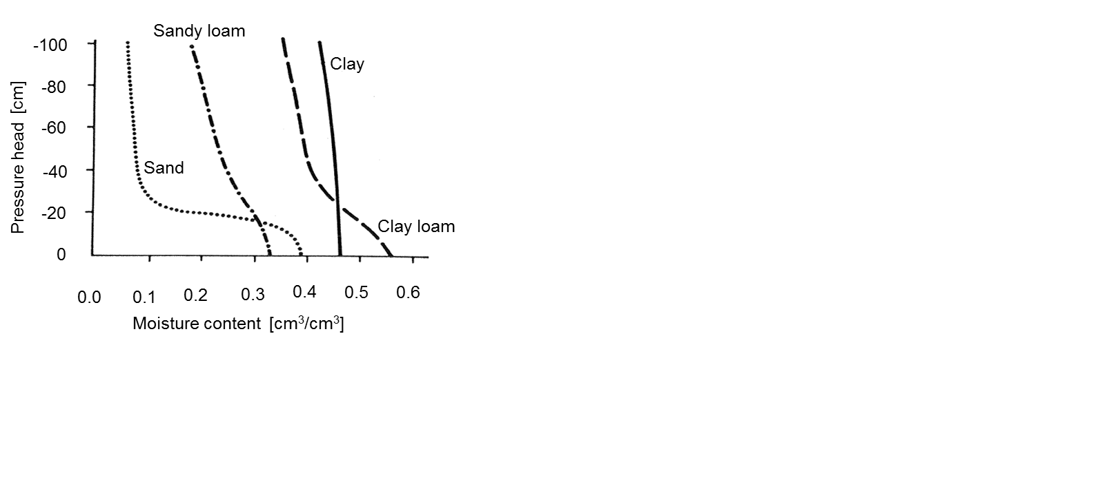
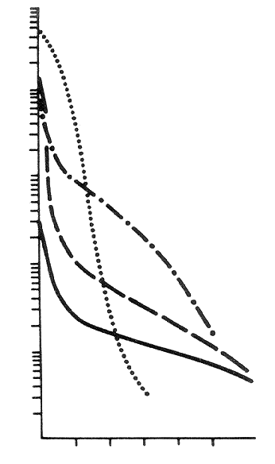
Soil hydraulic functions
Retention curve Function of hydraulic conductivity
1000
100
10
1
0.1
0.01
Hydraulic conductivity cm/day
Sandy loam
Clay loam
Sand
Clay
0 20 40 60 80 100
Suction head in cm

Slide 2
Soil moisture content
volumetric moisture content
θ
the measure of the volume of water present in
the pore space
V
θ
=
w
V
degree of saturation
S
, or
efective moisture content
θ
:
e
θ
θ
−
θ
S
=
θ
=
r
θ
,
e
θ
−
θ
s
s
r
where
θ
saturated moisture content (all pores filled)
s
θ
residual moisture content (does not participate on flow)
r

Slide 3
The Laplace, or Young-Laplace formula for capillary pressure is applied:
⎛
1
1
⎞
2
σ
p
=
σ
⎜
+
⎟
=
c
⎝
r
′
r
′
′
⎠
r
∗
where
r
*
the mean radius of capillary meniscus
σ
surface tension (for pure water under 20
°
C it is 0.0728
N/m)
r'
and
r''
the principal radii of a curvature
For a circular capillary located partially under water
2
σ
cos
ϕ
C
h
=
schematically:
h
=
1
c
ρ
c
gr
r
where
ϕ
contact angle
(wetting angle) at the contact of the
three phases (water
–
air
–
solid)
r
radius of the capillary
ρ
water density
The assumption: the air pressure in pores is equal to the atmospheric pressure (h_{a} = 0),
then:

Slide 4
Pressures in vertical capillary

Slide 5
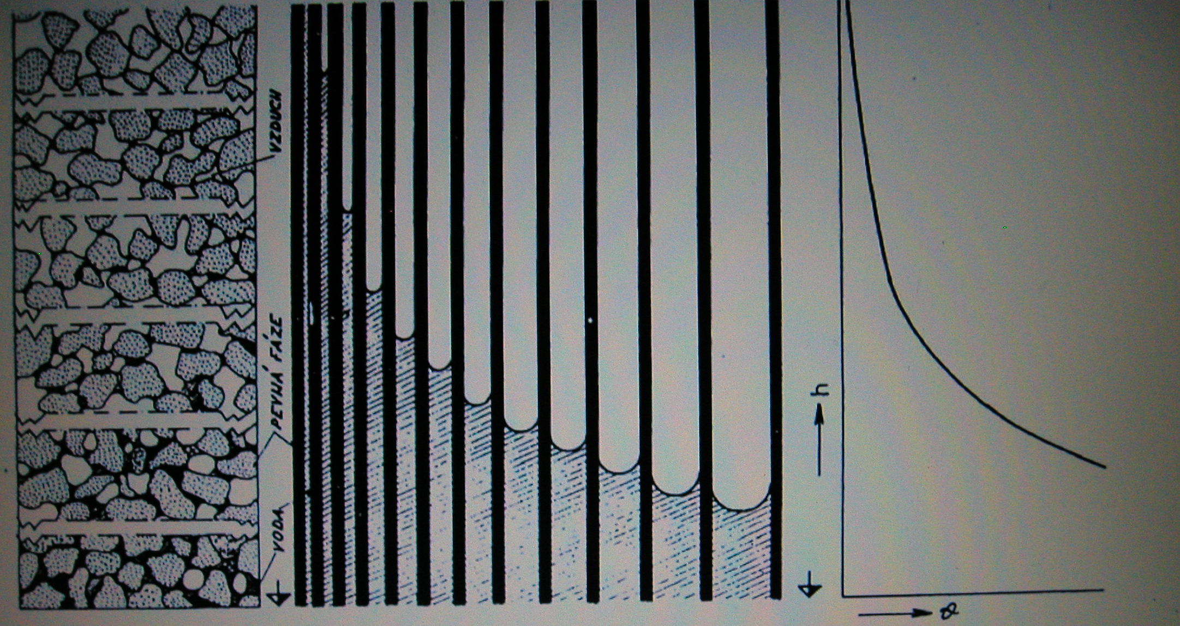
retention curve
air
solid phase
water

Slide 6
Retention curve
an equilibrium hydraulic characteristic of a porous medium
  in the unsaturated porous medium water held by capillary forces
  their intensity indirectly related to the degree of saturation
  in full saturation capillary forces vanish (and the influence of adhesive forces is negligible)

Slide 7
Retention curve
Functional relationship between the moisture content and the capillary suction head ( θ = θ(h_{c}) or S = S(h_{c}) or θ_{e} = θ_{e}(h_{c}) )
The assumption (capillary model of the porous medium):
  the porous media consists exclusively of the capillary pores
  (~ pores < 1 mm)
  the pore network is interconnected
  the constant density of water
What happens, when water saturation is reduced (drainage) from the soil, and when saturation is increased (wetting, imbibition) ?
as the soil is being dried, water is drained from the pore space, and air fills up the
evacuated space. As water leaves the pore space, the large pore drain first, as long as
a continuous pathway of pores which are occupied by water exists
during wetting the smallest pores fill the first, in dependence on the initial saturation
to each moisture content it corresponds
  a certain curvature of capillary menscii
  thus the capillary pressure (generalized Laplace‘ formulae)

Slide 8
Derivation of the retention curve is called
specific (water) capacity:
d
θ
C
(
h
)
=
−
c
dh
c
(a)
sand
(b)
sandy loam
(c)
sandy clay loam
(d)
clay loam
(e)
clay

Slide 9
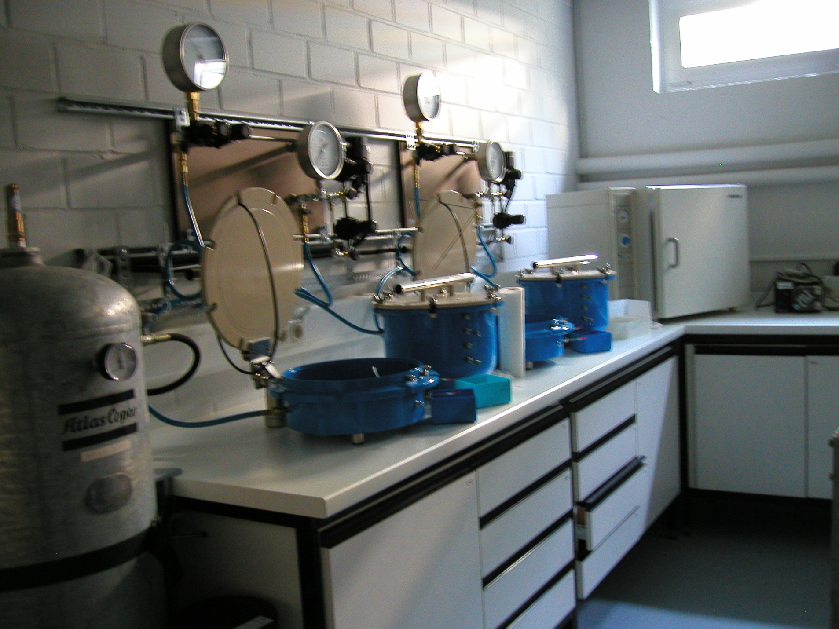

Slide 10
Hydraulic conductivity function
- the measure of the porous medium to conduct water
Hydraulic conductivity of one capillary
velocity of the laminar flow Hagen-Poiseuille law (for a circular capillary)
ρ
g
dH
u
=
−
r
2
8
μ
dl
where
u
average profile velocity
H
=
h
+
z
hydraulic head
dH/dl
hydraulic gradient
μ
dynamic viscosity of water [Pa s]
l
spatial coordinate in direction of the axis of
the capillary
the validity criterion - Reynolds number
-
Re
=
qd
ρ
/
μ
where
d
characteristic microscopic length of porous medium [L]

Slide 11
hydraulic conductivity of a capillary
K_{l}
dH
ρ
g
u
=
−
K
(
r
)
,
K
(
r
)
=
r
2
K
(
r
)
=
C
r
2
1
dl
1
8
μ
1
2
u
l
distribution of local velocities across the capillary

Slide 12
Soil hydraulic functions
Retention curve Function of hydraulic conductivity
1000
100
10
1
0.1
0.01
Hydraulic conductivity cm/day
Sandy loam
Clay loam
Sand
Clay
0 20 40 60 80 100
Suction head in cm

Slide 13
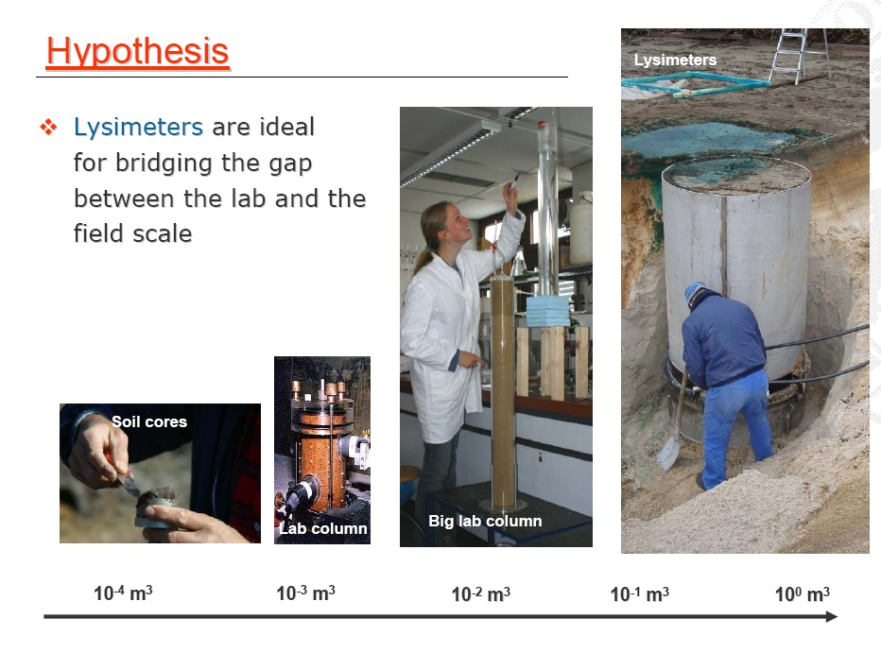

Slide 14
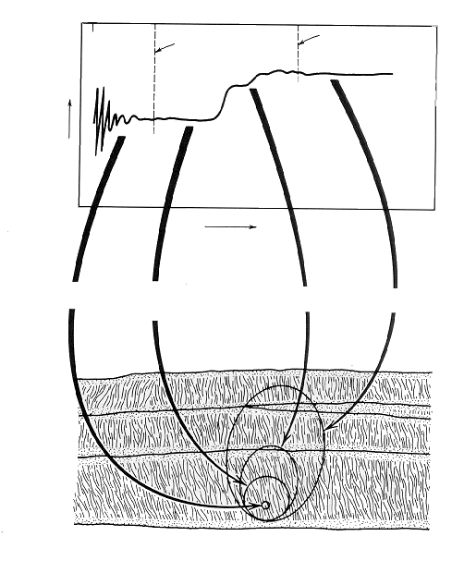
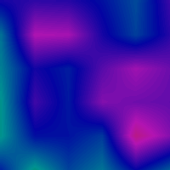
Measurement of macroscopic characteristics
scale of experiment spatial variability
hydraulic conductivity Ks
100
100
0
REV₁
REV₂
100
80
80
measured variable
80
60
60
60
objem
40
40
40
little sample
within a layer
two layers
profile
20
20
20
0
0
0
0
0
0
20
20
20
40
40
40
60
60
60
80
80
80
100
100
100
vzd
v
distance
á
lenost
[
[
[
m
m
]
]
]
0
0
0
40
40
40
80
80
80
K
K
K
estimate
[cm/min]
S
S
S

Slide 15
Soil hydraulic function estimation
What is measured:
points of retention curve
saturated hydraulic conductivity
retention curve function is obtained by fitting a mathematical expression
( e.g. van Genuchten, Brooks and Corey)
relative hydraulic conductivity function K_{r} is estimated from retention curve applying
a hydraulic model theory (Mualem, Burdine)
function of hydraulic conductivity is obtained by multiplying of K_{r} by measured
hydraulic conductivity K_{s}

Slide 16
Determination of hydraulic conductivity function of porous media
Theory of capillary models (Childs and Collis-George, 1950)
based on retention curve (RC) of a given media
h
(
θ
)
Assumption: RC expresses also the pore radii distribution
and mutual relationship is given by the Laplace expression
For such a case it is possible to calculate the hydraulic conductivity of pores filled
with water and than to evaluate the value of relative hydraulic conductivity
The unsaturated hydraulic conductivity is than determined as
K
′
(
θ
)
=
K
(
θ
)
K
*
r
s
where
K
*
is measured saturated hydraulic conductivity [LT-1]
(experiment)
s

Slide 17
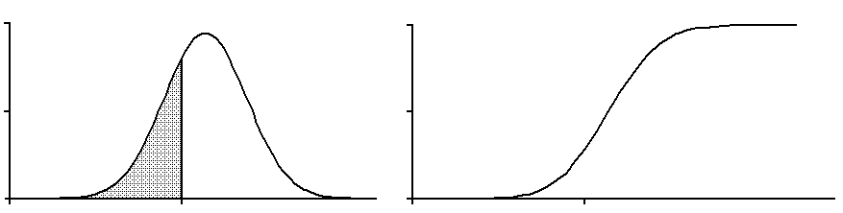
RETENTION CURVE and STATISTICAL DISTRIBUTION OF PORE SIZES
Statistical distribution of pores radii
-
distribution function
F
(
r
):
r
F
(
r
)
=
∫
f
(
r
)
dr
0
where
f (r)
frequency of relative distribution of pores of various radii
1
f
(
r
)
F
(
r
)
F
(
r
)
r
r
F
(
=
r
)
S
(
r
)
where
r
is a pore radius (pores of less
r
are filled with water)
Composing
S(r)
and
h_{c}(r)
the retention curve is obtained:
S
=
S
(
r
)
⎫
⎪
⎬
S
=
S
(
h
)
=
⎪
c
h
h
(
r
)
⎭
c
c

Slide 18
Hydraulic conductivity of a circular capillary
K_{l}
dH
ρ
g
u
=
−
K
(
r
)
,
K
(
r
)
=
r
2
K
(
r
)
=
C
r
2
1
dl
1
8
μ
1
2
u
l
local velocities within a capillary

Slide 19
Hydraulic conductivity of a capillary bunch
Macroskopic flux rate within a bunch of capillaries
(obtained by integration of microscopic flux rates)
=
1
∫
=
1
∫
v
(
A
)
u
dA
u
dA
w
A
A
w
A
w
A
where
A_{w}
w
w
part of the cross section area containing capillaries filled with water
The relationship between
A_{w}
and
r
is assumed (and also
dA/ A_{w} = f(r ) dr/F(r_{w})).
Then:
1
r
w
v
(
r
)
=
∫
u
(
r
)
f
(
r
)
dr
w
F
(
r
)
w
0
where
r_{w}
is the radius of the biggest pore filled with water.
Also holds (dF/F = dS/S = dθ/θ ) :

Slide 20
Applying the Hagen – Poiseuille law the flow density is obtained
(q = θv, F = S = θ/θ_{S} ):
⎛
r
w
⎞
dH
q
(
r
)
=
−
⎜
C
θ
∫
r
2
f
(
r
)
dr
⎟
w
⎜
2
s
⎟
dl
⎝
0
⎠
Alternatively:
⎛
S
1
⎞
dH
⎛
θ
1
⎞
dH
q
(
S
)
=
−
⎜
C
2
C
θ
∫
dS
⎟
,
q
(
θ
)
=
−
⎜
C
2
C
∫
d
θ
⎟
⎜
1
2
s
h
2
⎟
dl
⎜
1
2
h
2
⎟
dl
⎝
0
c
⎠
⎝
0
c
⎠
Can be simplified as:
=
−
dH
q
K
dl
where
K
is
the hydraulic conductivity of a bunch of capillaries

Slide 21
Thus
K(r) :
r
K
(
r
)
=
C
θ
∫
r
2
f
(
r
)
dr
2
s
0
(Index
w
left behind to simplify)
This hydraulic conductivity function depends on
-
geometry of the capillary bunch
-
properties of a fluid phase (constant
C₂)
The characteristic independent on the properties of a liquid phase is
permeability k :
ρ
g
θ
r
ρ
g
K
(
r
)
=
s
∫
r
2
f
(
r
)
dr
=
k
(
r
)
μ
8
μ
0

Slide 22
Hydraulic conductivity as a function of moisture content:
θ
1
K
(
θ
)
=
C
2
C
∫
d
θ
1
2
h
2
0
c
Relative hydraulic conductivity:
θ
d
θ
∫
K
(
θ
)
h
2
K
(
θ
)
=
=
0
c
r
K
(
θ
)
θ
s
d
θ
s
∫
h
2
0
c
where
K
(
θ
)
=
K
is
the saturated hydraulic conductivity
s
s
.
Relative hydraulic conductivity
–
independent on a fluid phase
(equals also to the relative permeability)

Slide 23
Methods used to estimate K_{r}
Burdine (1953):
θ
d
θ
∫
⎛
θ
⎞
2
h
2
K
(
θ
)
=
⎜
⎟
0
c
r
⎜
θ
⎟
θ
θ
⎝
⎠
s
d
s
∫
h
2
0
c
Mualem (1976):
⎛
θ
d
θ
⎞
2
⎜
∫
⎟
⎛
θ
⎞
1
/
2
⎜
h
⎟
K
(
θ
)
=
⎜
⎟
⎜
0
c
⎟
r
⎜
θ
⎟
θ
d
θ
⎝
⎠
⎜
s
⎟
s
⎜
∫
⎟
⎝
h
c
⎠
0
(
θ
/
θ
s
)
b
-
influence of relative tortuosity – (fictive vertical curvature of capillaries)

Slide 24
ANALYTICAL EXPRESSION OF RETENTION CURVE
  Measured points are fitted by a selected mathematical expression
  Commonly used expressions:
Brooks and Corey (1964)
  λ a H_{b} parameters (λ − pore size distribution index, H_{b} – bubling pressure)
  θ_{e} efective moisture content
  θ_{s} saturated moisture content
  θ_{r} residual moisture content

Slide 25
van Genuchten (1978)
  α, n a m fitting parameters
  usually m given as m = 1-1/n, parameter n then > 1
Often terms effective saturation S or S_{e} are used instead of θ

Slide 26
Fitted analytical curves
measured points

Slide 27
Estimate of hydraulic conductivity function
Relative hydraulic conductivity by Brooks and Corey
where a and b of Burdine’s capillary model a = 2 and b = 3,
of Mualem’s capillary model a = 2 b = 2.5
⎧
⎛
H
⎞
a
+
b
λ
⎪
⎜
b
⎟
h
<
H
(
)
⎪
⎝
h
⎠
b
+
λ
K
h
=
⎨
or
K
(
θ
)
=
θ
b
a
/
r
⎪
r
e
e
⎪
1
h
≥
H
⎩
b

Slide 28
In connection with van Genuchten’s retention curve Mualem’s capillary model is used.
Relative hydraulic conductivity is expressed as:
Or inversely
Parameters of a selected expression of retention curve are evaluated in optimization procedure.
The commonly used fitting code is the public domain software Program RETC
(http://www.ussl.ars.usda.gov/)

Slide 29
(a)
sand
(b)
clay loam
(c)
sandy clay loam
(d)
clay loam
(e)
clay

Slide 30
RC parameters of 5 different soils
θ
θ
α
n
r
s
-
[
1
-
]
[
-
]
[cm
]
[
-
]
(a)
sand
0.045
0.43
0.144
2.68
(b)
sandy loam
0.065
0.41
0.075
1.89
(c)
sandy clay
0.070
0.45
0.020
1.41
loam
(d)
clay loam
0.100
0.39
0.060
1.48
(e)
clay
0.070
0.36
0.005
1.09

Slide 31
7
Infiltration outflow experiment
fully controlled 1D vertical flow
a simple test to detect preferential flow
Disc infiltrometr
20 cm
Pressure head B.C.
Tensiometers
Measured features
inflow flux rate
outflow flux rate
course of moisture content
pressure heads
25 cm
Seepage face B. C.

Slide 32
