Slide 1
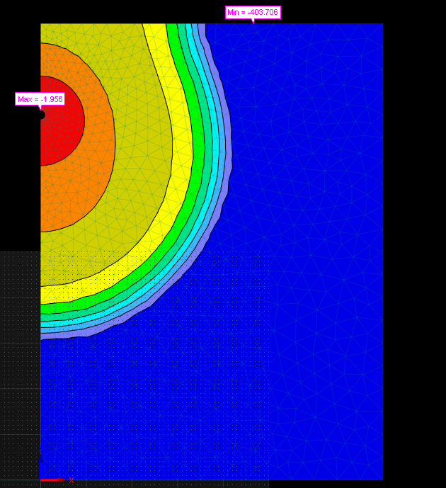
Hydrus 2D
Tailin Li (Terrence)
tailin.li@fsv.cvut.cz
Czech Technical University in Prague, Czech Republic
2022.04.04

Slide 2
Objective
1. Get familiar with the Hydrus 2D simulation
2. Simulate both water flow and solute transport processes in Hydrus 2D

Slide 3
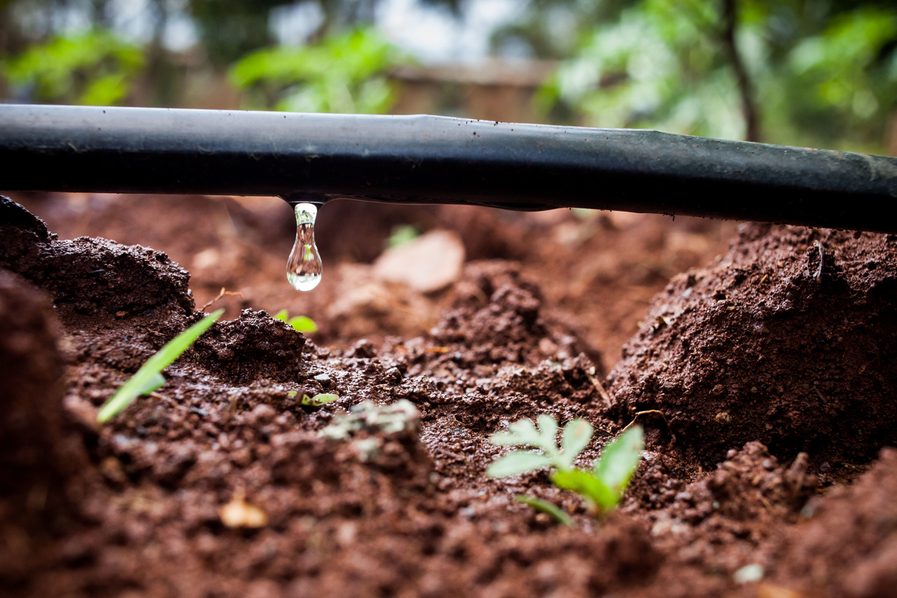
Drip Irrigation

Slide 4
Simulation
A subsurface line source (e.g. drip irrigation) of water (first without and then with a solute) in a vertical cross-section. The (x, z) transport domain is 75 x 100 cm², with the source located 20 cm below the soil surface on the left boundary of the transport domain. The radius of the irrigation pipe is 1 cm. Infiltration is initiated with a variable flux boundary condition and is maintained for 1 day, with the duration of the solute pulse being 0.1 days; with 2 cycles per week.

Slide 5
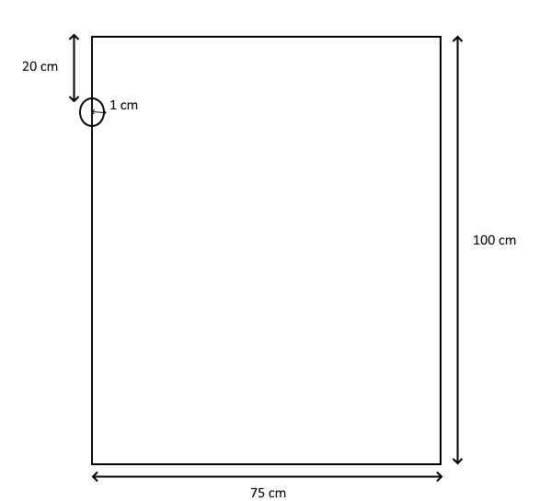
Conceptual model

Slide 6
Water flow model

Slide 7
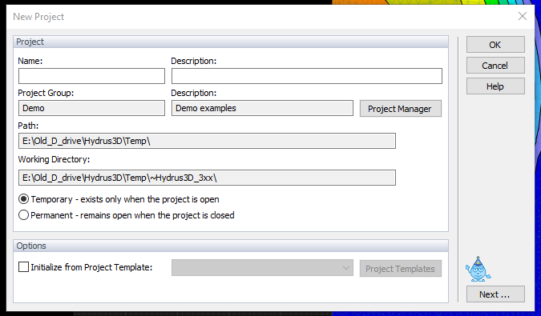
Create a new project

Slide 8
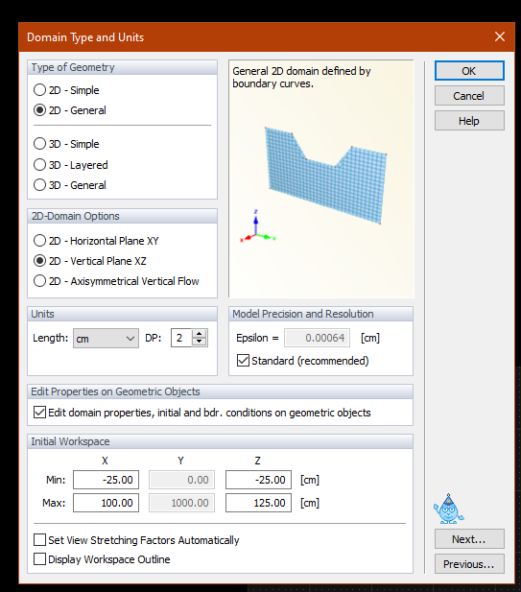
Domain Type and Units

Slide 9
Main Processes and Add-on Modules

Slide 10
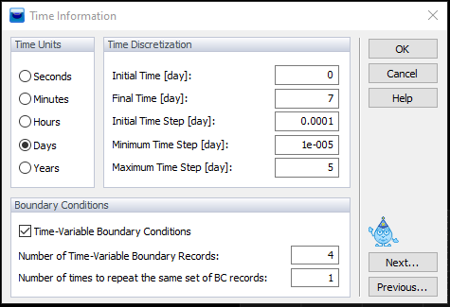
Time information

Slide 11
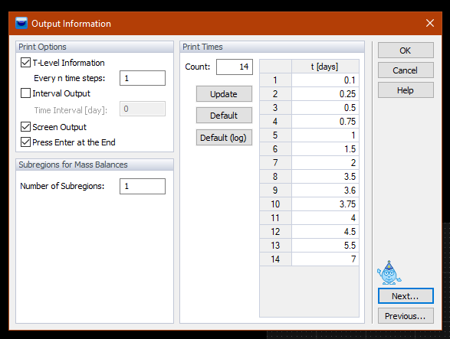
Output information

Slide 12
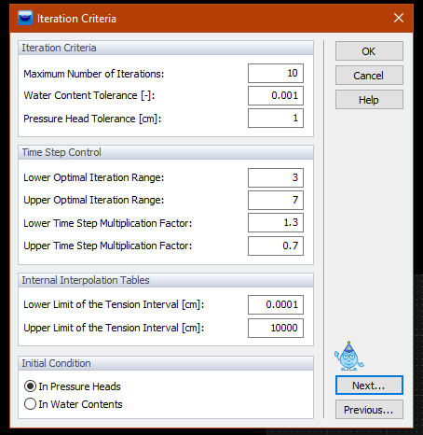
Iteration Criteria

Slide 13
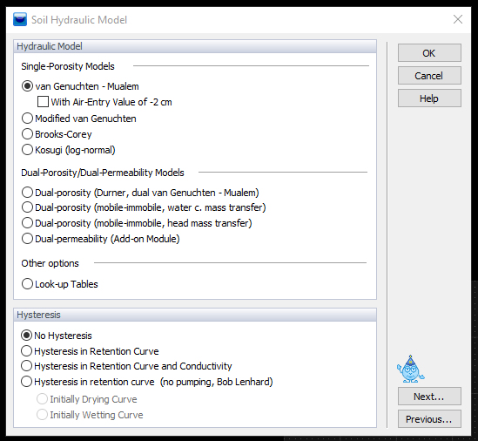
Soil Hydraulic Model

Slide 14
Soil Hydraulic Model

Slide 15
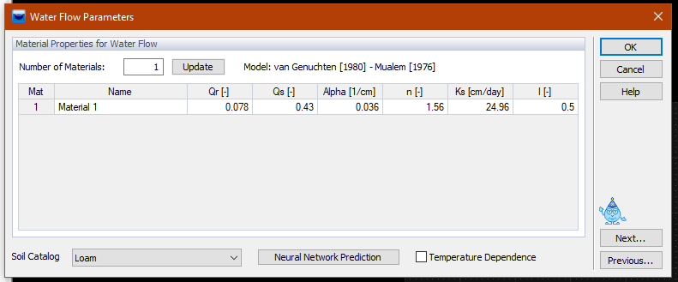
Water flow parameters

Slide 16
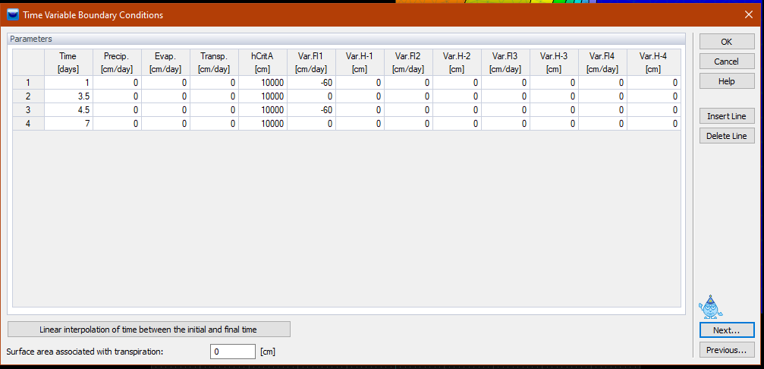
Time Variable Boundary Conditions

Slide 17
Mesh Parameters

Slide 18
Mesh Parameters

Slide 19
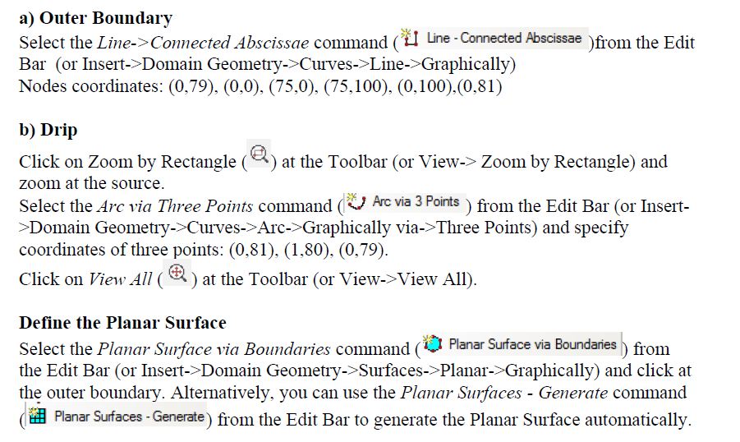
Generate Geometry

Slide 20
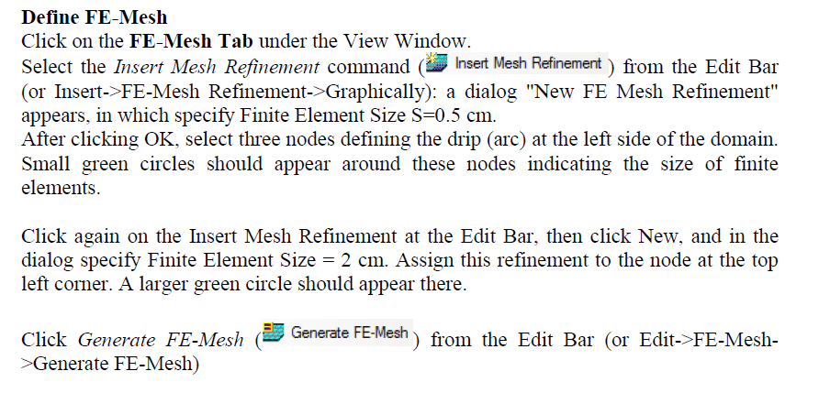
Define Mesh

Slide 21
Initial condition

Slide 22
Boundary conditions

Slide 23
Observation points

Slide 24
Visualizing results

Slide 25
Solute transport model

Slide 26
Copy and create a new project

Slide 27
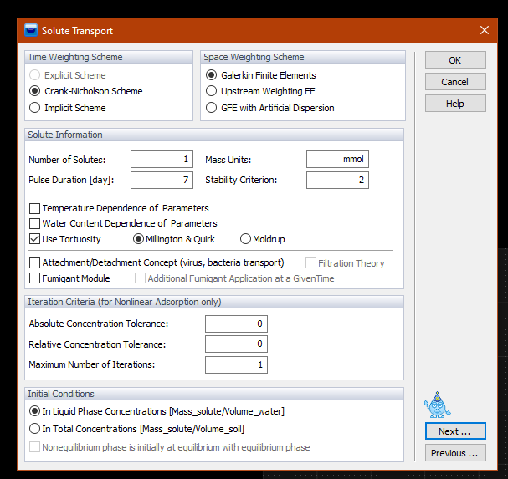
Solute transport general information

Slide 28
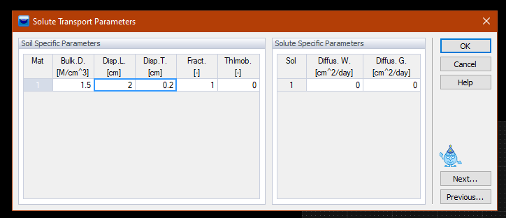
Solute transport parameters

Slide 29
Reaction parameters

Slide 30
Time variable boundary conditions

Slide 31
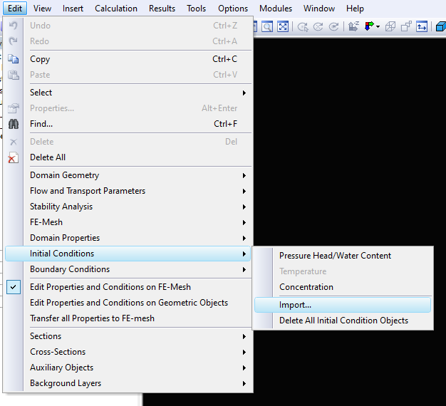
Import initial condition

Slide 32
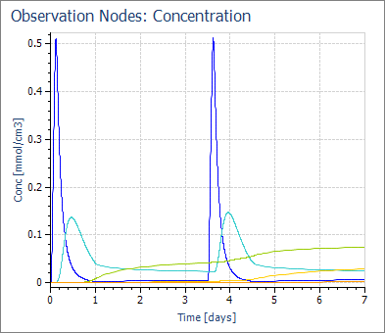
Running model & visualizing results

