Slide 1
Hydrus 2D
Tailin Li (Terrence)
tailin.li@fsv.cvut.cz
Czech Technical University in Prague, Czech Republic
2022.04.11

Slide 2
Objective
1. Simulate furrow irrigation with salute transport with Hydrus 2D
2. Simulate flow in riparian areas with Hydrus 2D

Slide 3
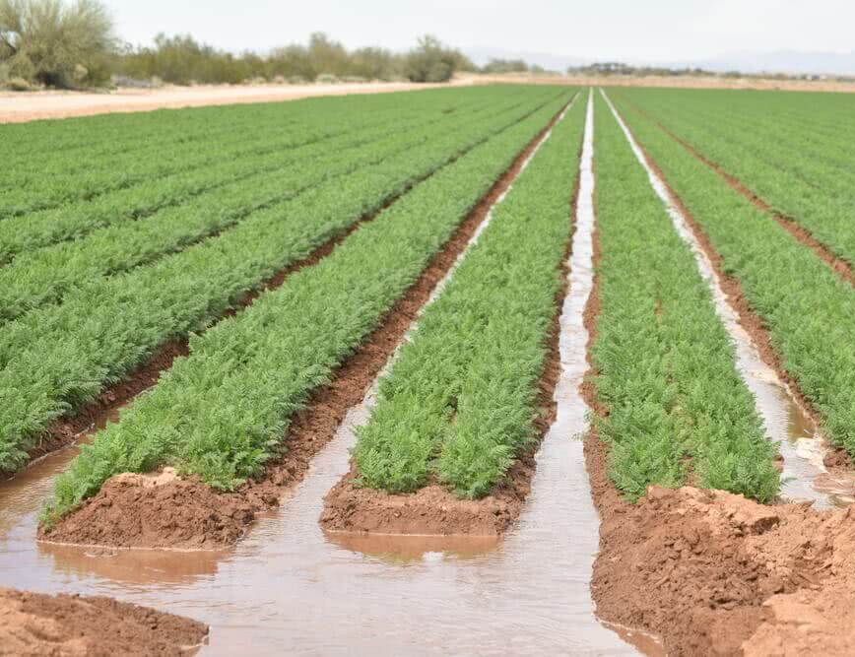
Furrow irrigation
Furrow irrigation is a method of laying out the water channels in such a way where gravity plays the role of providing just enough water for suitable plants to grow
For more info: https://civiltoday.com/water-resource-engineering/irrigation/282-furrow-irrigation

Slide 4
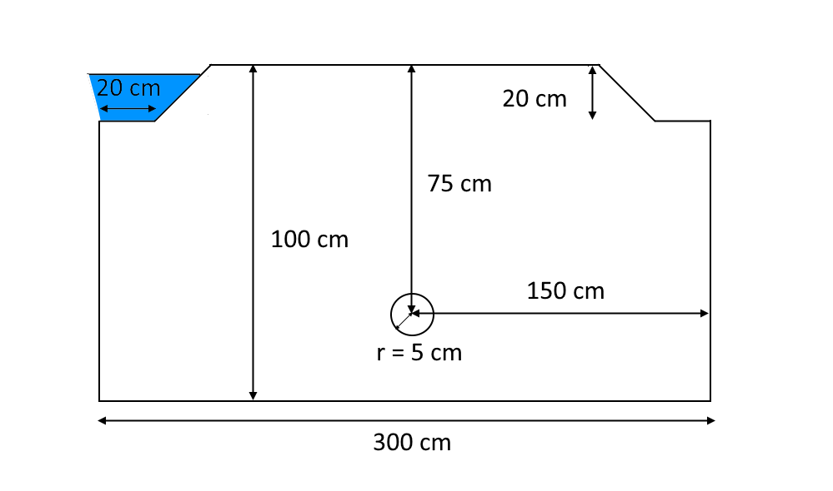
This exercise considers alternate furrow irrigation into a soil profile with a subsurface drain. Water infiltration is evaluated for 100 days, with a solute pulse being added to the irrigation water during the first 50 days. The soil profile is 1 m deep with furrows 3 m apart; the drain is located in the middle between the two furrows at a depth of 75 cm. Alternate furrow irrigation is initiated by ponding the left furrow. The ponded water depth is 12 cm.

Slide 5
Additional information
Only one soil material: Silt
print times
0.5
1
2.5
5
10
20
30
40
50
50.5
51
52.5
55
60
70
80
90
100
Bulk Density = 1.5 cm3/g Longitudinal Dispersivity, Disp.L = 5 cm Transverse Dispersivity, Disp.T = 0.5 cm Molecular Diffusion Coefficient for Liquid Phase, Diffus.W.=2 cm2/d
FE-Mesh Parameters:
TS = 10 cm
2 refinement points (S=2.5) on the left furrow

Slide 6
Additional information
Initial condition: Equilibrium from the lowest located point
Bottom pressure head IC = 50 cm
Solute concentration = 1

Slide 7
Q1. What boundary should be assigned for the ponded furrow?
Q2. What boundary should be assigned for the tile drainage?

Slide 8
Q3. How much water left from the tile drain?
Q4. When did the concentration reach the highest value in the tile drain?

Slide 9
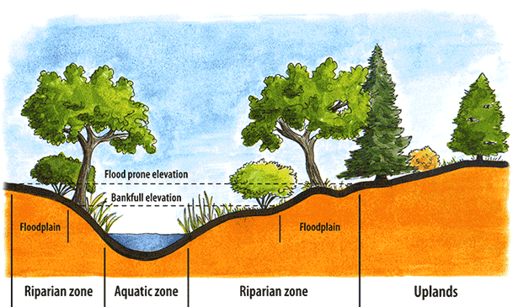
Riparian zone
This exercise considers water flow and solute transport in a vertical transect with a stream. The transport domain is relatively complex and consists of objects formed by polylines and splines. The problem, divided into three parts, also demonstrates how results of a previous simulation can be used in follow-up calculations with different boundary conditions or having additional features. At first (A), steady state water flow in the transect towards the stream is calculated. Second (B), a source (e.g., simulating water drainage from waste disposal site) is added to the soil surface about 30 m to the left of the stream for a duration of 100 d
(Image source: https://www.slco.org/watershed/streams-101/the-riparian-zone/)

Slide 10
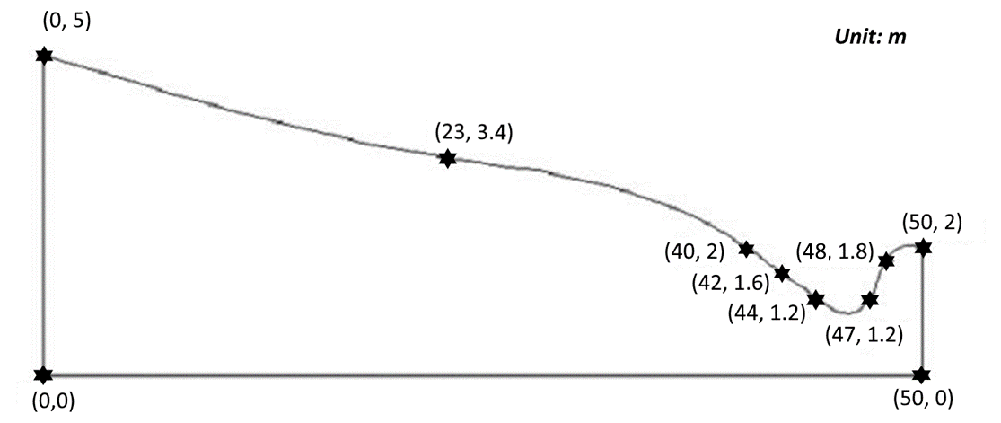
Conceptual model

Slide 11
Water flow to a stream
print times
1
5
10
25
50
100
Simulation period: 100 days
Soil material: loam
FE-Mesh parameters:
TS = 25 cm
Stretching Factor = 3
Stretching direction = X - direction

Slide 12
Additional information

Slide 13
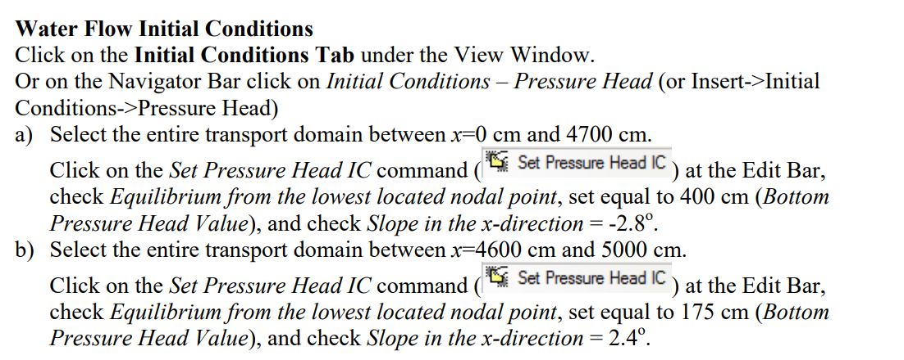
Additional information

Slide 14
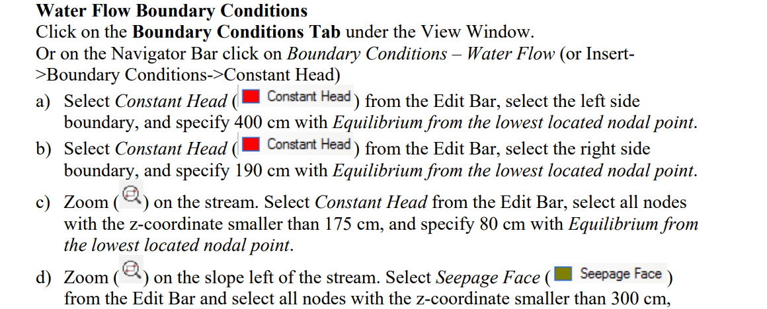
Additional information

Slide 15
Q1. Is this stream gaining or loosing stream?
Q2. What is the maximum depth of the unsaturated soil after 100 days?
Q3. How to define the solute transport if the source is not located at the constant flux/head flow boundary?

