Slide 1
Seminar #10
HYDRUS 2D - introduction, setting up the domain, results visualization

Slide 2
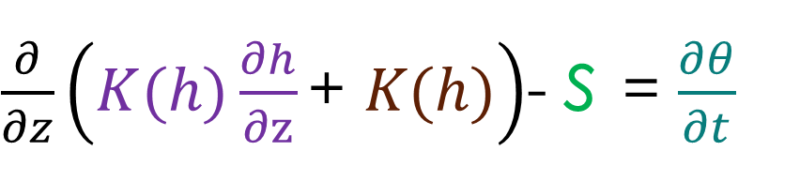
Richards equation
Theory repetition
van Genuchten
$\frac{∂}{∂x}\left(K_{x}(θ)\frac{∂h}{∂x}\right)+\frac{∂}{∂y}\left(K_{y}(θ)\frac{∂h}{∂y}\right)$+$\frac{∂}{∂z}\left(K_{z}(θ)\frac{∂h}{∂z}\right)$+ $\frac{∂Kz}{∂z}$= $\frac{∂θ}{∂t} …in 3D$
$\frac{∂}{∂z}\left(K(h)\frac{∂h}{∂z}\text{+ }K(h)\right)$- s = $\frac{∂θ}{∂t}$
Mualem

Slide 3




Theory repetition
Advection dispersion eq. as implemented in HYDRUS
Sink (flow)
Reactions (decay)
c – solute concentration in liquid phase
s – solute concentration on solid phase
Equilibrium adsorption:
Molecular diffusion coef.
Long. dispersivity (input)
Dispersion coefficient
Tortuosity factor
Mean pore velocity
Distribution coeff.

Slide 4

Discretization in 1D
Real domain:

Slide 5

Discretization in 1D
Top boundary node
Node
1D domain:
Element
Bottom boundary node

Slide 6
Discretization in 1D
Top boundary node
TIME:
SPACE:
Node
Element
t₀
∆t
t_{end}
∆t_{init}
∆t_{min}
∆t_{max}
Bottom boundary node

Slide 7
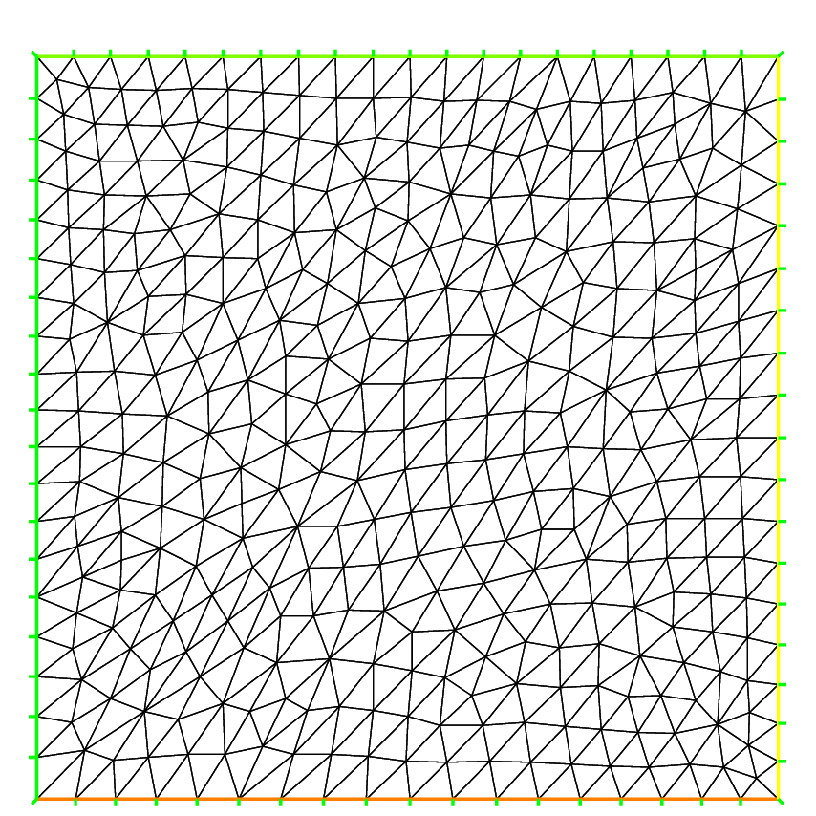
Discretization in 2D
boundary node
boundary element
root zone (sink)
element
node

Slide 8
Initial conditions
Richards eq.:
Matric potential / water content distribution
ADE:
Initial solute concentration distribution
h₂=-400 cm
c₂=20 mmol
h₁=-200 cm
c₁=0 mmol

Slide 9
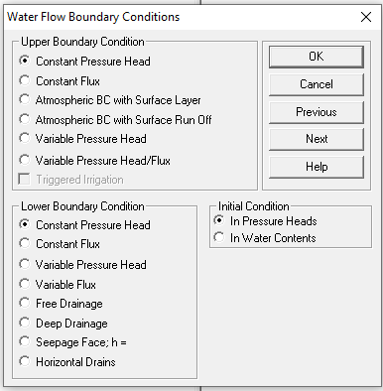
Boundary conditions - Repetition
Known water level in a stream
Ponded infiltration
h
Ground water level
e.g. h = 0 cm

Slide 10
Boundary conditions
Known water level in a stream
Ponded infiltration
h
Ground water level
e.g. h = 0 - 10 cm

Slide 11
Boundary conditions
Irrigation, sprinkling, evaporation, rain
q
q
Impermeable layer (bedrock)
q = 0 cm/d

Slide 12

Boundary conditions
Rainfall + evaporation (with variable intensity)
Water, which cannot infiltrate, leaves the system as a surface runoff
Water, which cannot infiltrate, stays in depressions and will infiltrate later
q
Unit gradient – water continuous to flow into “an infinite” soil profile below

Slide 13

Boundary conditions
Interface between soil and atmosphere
Lab soil sample
Groundwater seepage Tile drain

Slide 14
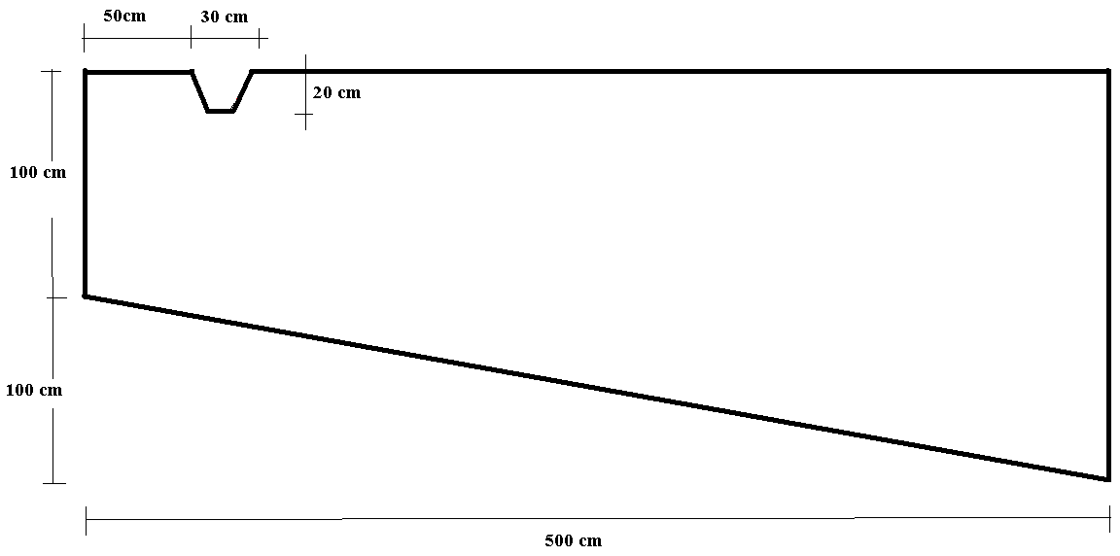
Ditch infiltration with impermeable bottom boundary

Slide 15
Ditch infiltration with impermeable bottom boundary
The ditch was filled with 8 cm of water.
Initial conditions: pressure 0 cm at the lowest point of the domain, the rest in equilibrium
Boundary conditions: no flux – everywhere except the ditch and the tile drain
Duration: 50 days
Soils: upper horizon loam, bottom layer sandy loam
Loam
Sandy loam

Slide 16
Ditch infiltration with impermeable bottom boundary
Transport:
1. Simulate a conservative tracer, dissolved in infiltrating water for a duration of 1 day, conc. 5 mg/cm².
2. Consider solute B already located in the simulated domain (pick a location between the ditch and drainage). Kd = 1.1, conc. 10 mg/cm².
Dispersivity in both directions: 40 cm
Topsoil bulk density: 1.28 g/cm³, bottom 1.40 g/cm³
Print information: select 500 print times with time step 12 hours
Flowing particles: Insert 5 – 15 flowing particles (few close to the ditch, rest as you wish)
Loam
Sandy loam

Slide 17
Ditch infiltration with impermeable bottom boundary
a/ Observe, how is the domain being filled with water and how do the solutes propagate.
b/ Identify locations with the highest velocities.
c/ How much water/solutes were infiltrated and recycled via the drainage after 10 and 50 days?
d/ How much solutes remain in the domain after 50 days?
Loam
Sandy loam

Slide 18
(Task for H1D)
“complex” exercise where you need to use:
- RETC for hydraulic characteristics estimation
H1D for water flow through unsaturated zone
H1D for solute transport

Slide 19
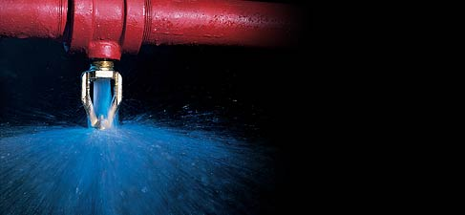
Calculate, how long does it take to clean the filter:
The filter (for dimensions see the fig.) is filled with a mixture of ground lime stone and quartz sand. The hydraulic characteristics were measured by the standard methods (retention curve on sand tank and in pressure apparatus) – see table.
Saturated hydraulic conductivity (Ks) of the material is 220 cm/d.
Initial conditions: uniform h_{init}= -600 cm
Boundary conditions:
- top: sprinkler with intensity 4.2 mm/h
- bottom: water drips freely out from the filter, determine the correct BC
h (cm) | θ
1 | 0.407
5 | 0.350
10 | 0.261
20 | 0.161
35 | 0.110
50 | 0.091
75 | 0.077
100 | 0.071
300 | 0.060
1000 | 0.0572
10000 | 0.057
D (∅) = 1 m
Top 50 cm contain a solute, concentration of 10 mg/cm³ of soil.
Transport characteristics:
Bulk density 1.5 g/cm3
Dispersivity: 15 cm
Molecular diffusion coefficient in water: 4 cm²/d
Kd = 0.6 mg/cm³ (linear adsorption isotherm)
h = 2m
Prepare a report:
brief task description
methodology
retention curve + van Genuchten’s parameters
description of Hydrus input parameters
Results:
  plot cumulative outflow from the filter and the tracer
  plot breakthrough curve in the middle of the filter
  How long does it take before a steady state flow is obtained?
  How long does it take to obtain 10 m³ of filtered water?
  How much tracer stays in the filter after 6 days?
  When is 95% of the solute washed out from the filter?

